Slide 1
Applications of Atomistic Modeling
Dane Morgan
Last Update: 9/9/21

Slide 2
Introduction to Atomistic Hamiltonians
Some atomistic modeling applications
Pros and cons of atomistic modeling
Skills needed for atomistic modeling

Slide 3
Applications
Understanding
Prediction
How, why, where of phenomenon
How does H diffuse through A?
Why is A harder than B?
Where does A bind to B?
Parameter values, new phenomena
What is the diffusivity of H in A?
How hard is A?
Will A bind to B and how strongly?

Slide 4
Applications Basic Materials Properties
Charge Density in LiCoO₂
Band structure of LiMnO₂
Energy versus lattice parameter for fcc Al

Slide 5
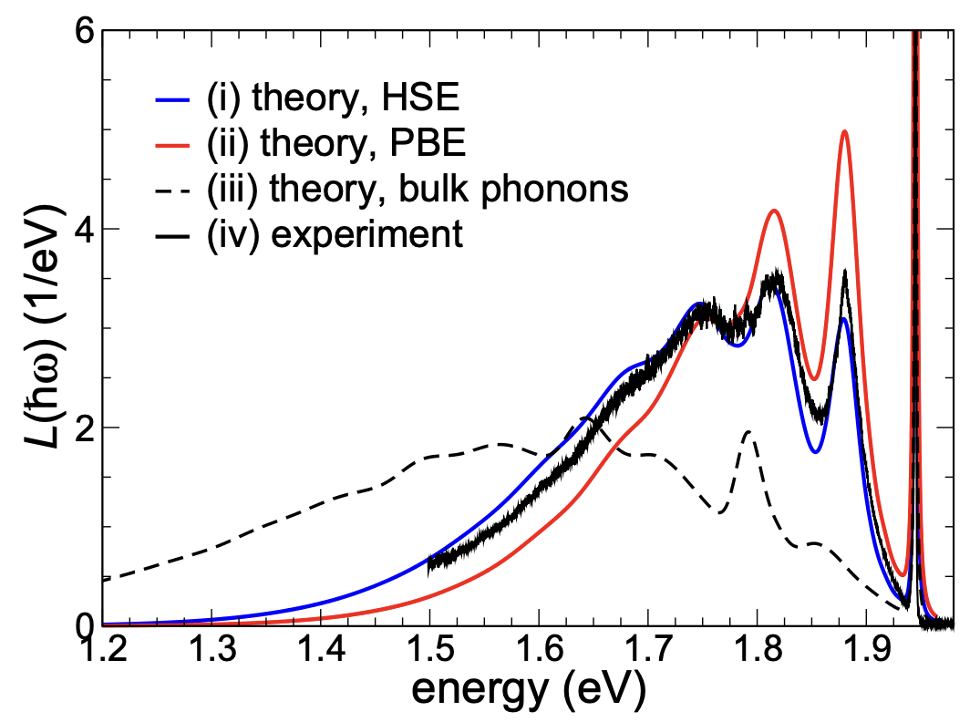
Applications – Spectroscopy and Transport
NV center in diamond
electron and spin lifetime of Si
J. Xu, Nat. Commun. 2019.
A. Alkauskas et al, New J. Phys. 16, 073026 (2014)
Spin transport in graphene under B field

Slide 6
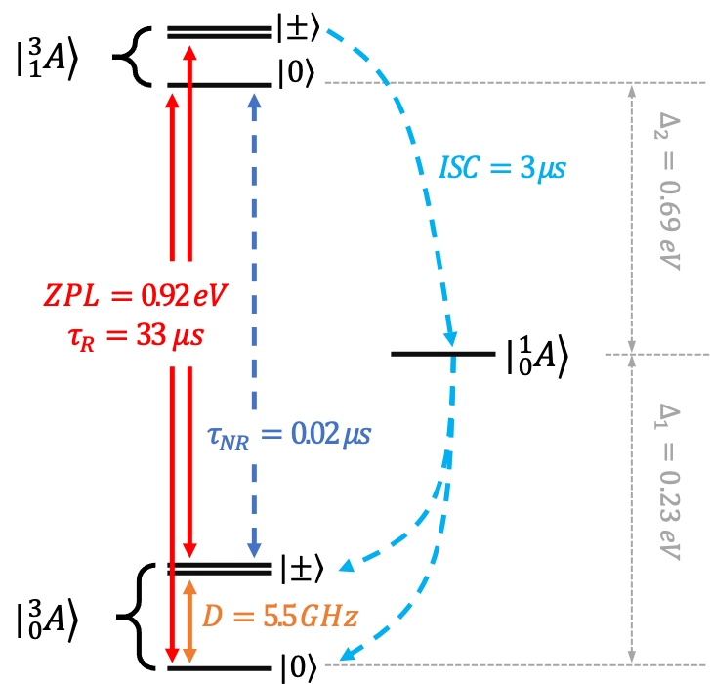
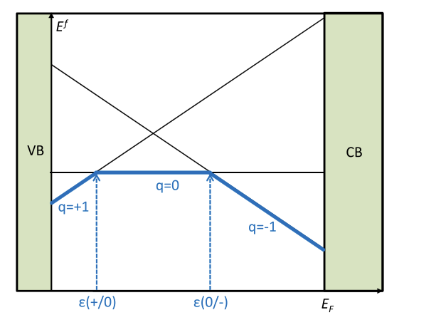
Applications – Thermodynamics and Kinetics
Christoph Freysoldt et al,
Defect formation energy
Rev. Mod. Phys., Vol. 86, No. 1, 2014.
T. J. Smart et al, NPJ Comput. Mater. 7, 59, (2021).

Slide 7
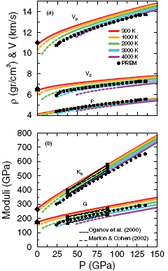
Applications: Elastic Properties of Earth Mantle Materials
Extreme conditions: T=2000-4000K, P=25-130GPa, >600km below earth’s surface ⇒ very challenging experiments
Density and acoustic wave speeds in earth mantle material calculated from quantum methods
Compared to acoustic measurements (PREM)
Allows prediction of temperatures and new acoustic regions
Wentzcovitch, et al., Phys Rev Lett ‘04

Slide 8
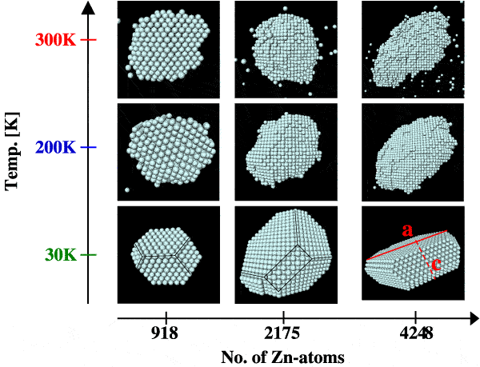
Applications Precipitate Morphology
(Muller, et al. ‘01)
Quantum mechanical and thermodynamic modeling give detailed predictions for Zn precipitate morphology vs. temperature, precipitate size for AlZn alloys.

Slide 9
Atomistic Modeling Pros and Cons Pros
Complete control
Perfect materials characterization
Sensitivity testing
Extreme conditions possible
Access to every aspect of the output
Efficient
Inexpensive
Fast
Can explore many possibilities
Supplements/Compliments Experiment
Aid in experimental interpretation and analysis
Complimentary domains
Easy to model
Easy to measure

Slide 10
Atomistic Modeling Pros and Cons Cons
Limited by being able to solve/simulate quickly with an accurate Hamiltonian
Constant struggle to be able to model relevant phenomena accurately
Atomic models often combined with higher level models for larger time and length scales (multiscale modeling)

Slide 11
Useful Skills/Background (Interdisciplinary)
Physics: Hamiltonians, solution/simulation methods
Computer Science: Hardware, software algorithms
Applied Mathematics: Algorithms
Materials Science, Chemistry, Biology: Areas of applications
⇒ Interdisciplinary!! Can’t know it all so don’t be discouraged!!

Slide 12
Summary
Atomistic modeling allows both understanding and prediction and has many applications
The power of atomistic modeling comes from the control, efficiency, and total access to results.
The limitations on atomistic modeling are the speed (length/time scales) and accuracy with which problems can be solved.
Atomistic modeling is an interdisciplinary field that both draws on many subjects and is used in many subjects.

Slide 13
END

Slide 14
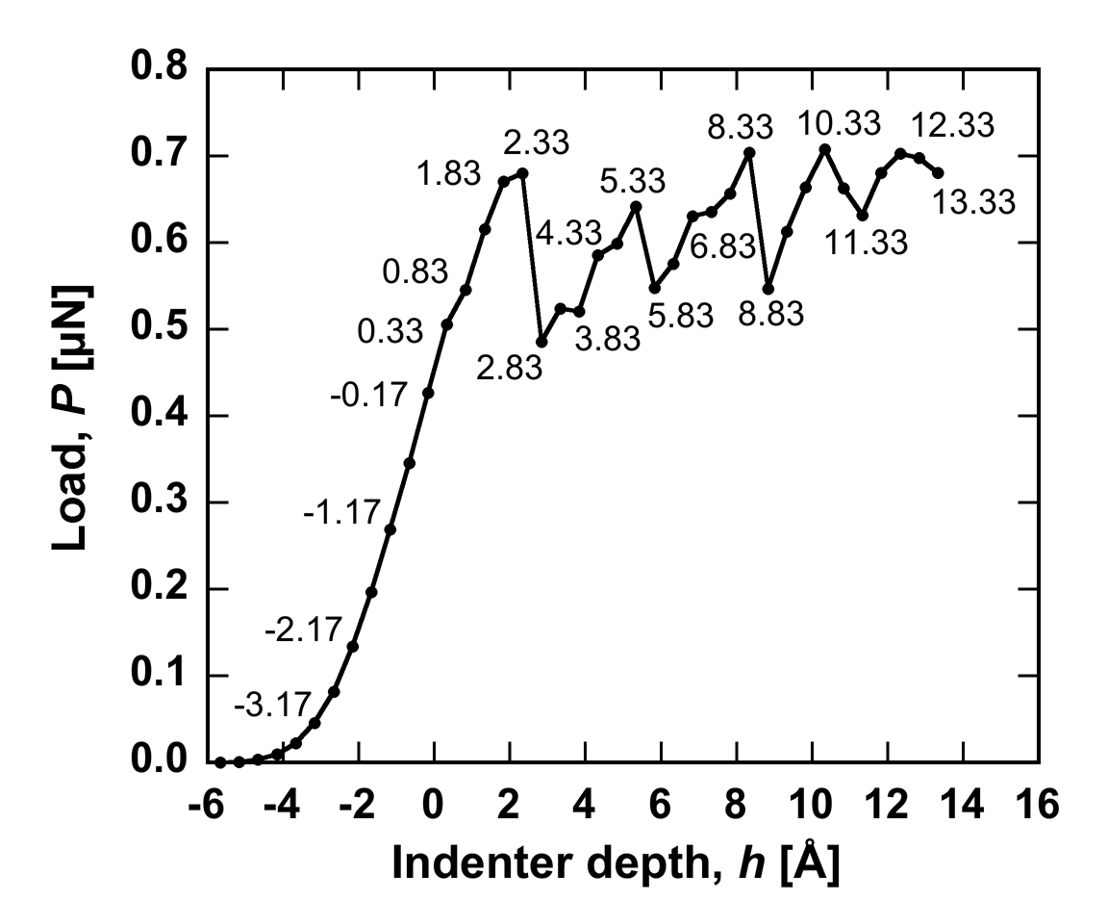
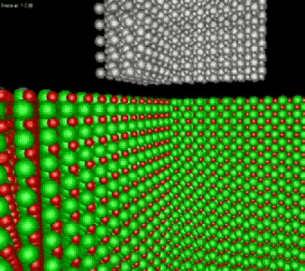
Application Processes in Nano Indentation
P-h response of 3C-SiC
(Courtesy of I. Szlufarska)
• Periodic load drops (~ 3Å) ~ lattice spacing
Slipping of atomic layers releases the accumulated stress

